Slide 1
NITRIFICATION
da Silva, ME 16052430
Gonde, L 17046832

Slide 2

WHAT IS NITRIFICATION?
Defined as the oxidation of ammonia to nitrite followed by the oxidation of nitrite to nitrate
Usually occurs in separate organisms
Can also occur as direct ammonia oxidation to nitrate in comammox bacteria
Comammox bacteria is any bacteria that can convert ammonia to nitrate through nitrification
1

Slide 3
NITRIFICATION SIMPLIFIED
Step 1
Step 1
Ammonium (NH₄⁺)
Step 2
Step 2
Nitrite (NO₂⁻)
Step 3
Step 3
Nitrate (NO₃⁻)
Oxidation
Oxidation
Notes:
List all of the steps used in completing your experiment.
Remember to number your steps.

Slide 4
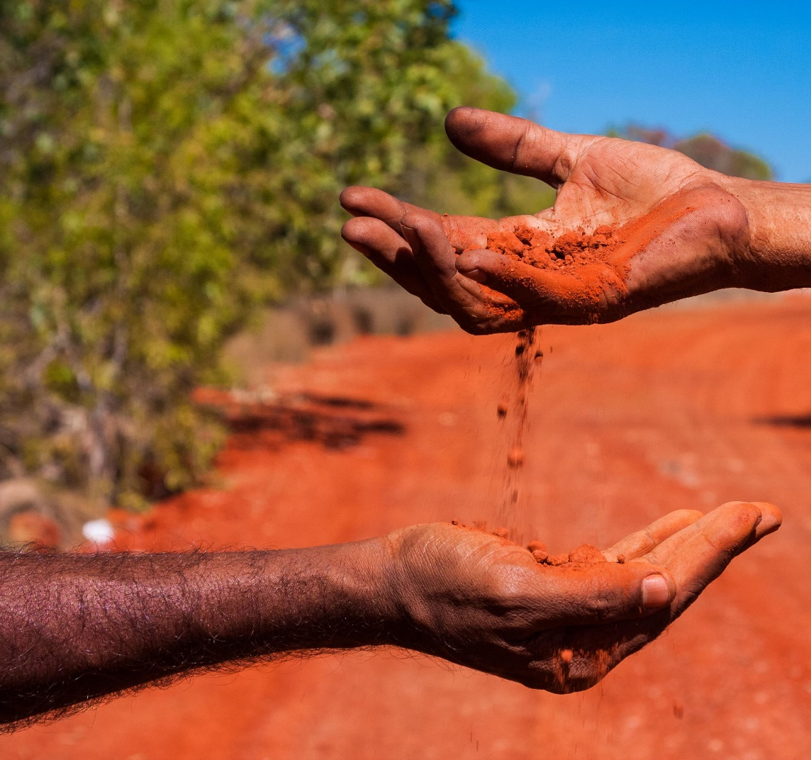
WHY IS IT USEFUL?
Ammonia is the most reduced form of nitrogen in soil
Nitrate is the most oxidised form of soil nitrogen
The most preferred chemical form of nitrogen uptake from soil or water for most plants is in the form of nitrate
Nitrification converts the most reduced form of soil nitrogen to its most oxidised form

Slide 5

NITRIFICATION IN AQUAPONICS
This process drives most aquaponic processes
Ammonia in the system must be converted for the plants
Otherwise, plants can suffer from ammonium toxicity
But there are no fish in hydroponics, so no ammonia is formed

Slide 6
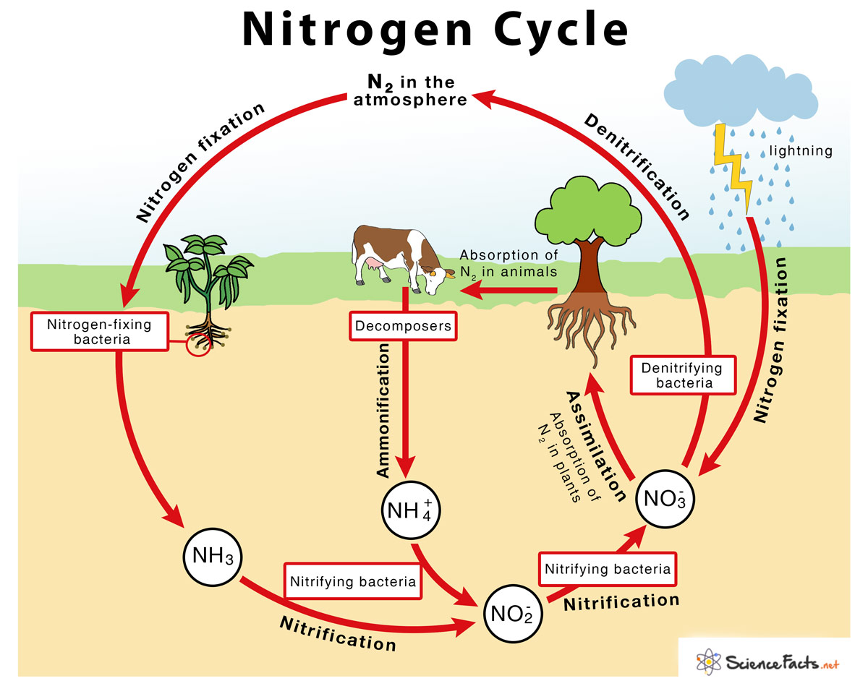
NITROGEN CYCLE
Nitrogen fixation
Nitrification
Assimilation
Ammonification
Denitrification

Slide 7
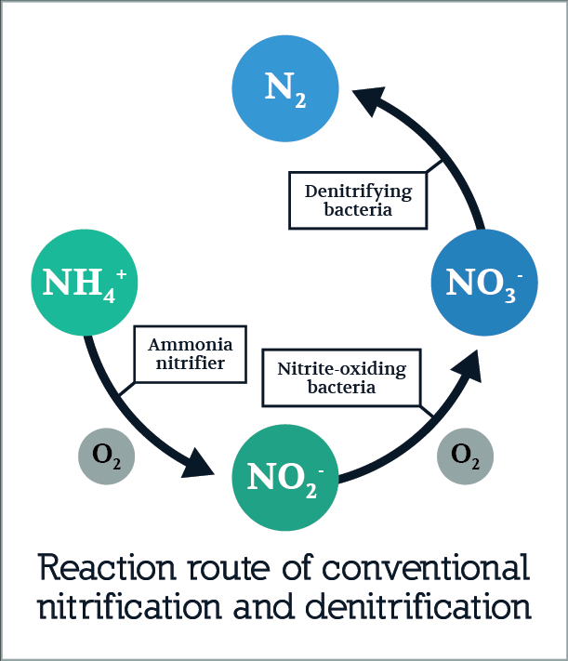
ALTERNATING AEROBIC AND ANAEROBIC (AAA)
Nitrification is aerobic
NH₄⁺ → NO₃⁻
Autotrophs
Denitrification is anaerobic
NO₃⁻ → N₂
Heterotrophs

Slide 8
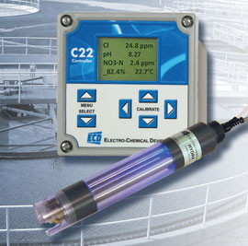
POSSIBLE CONTROL STRATEGY
Ammonia analyser & Nitrate analyser
Online measurements
High maintenance
Model-based control strategy
Predict the ammonia and nitrate amounts
Good models are complex models
Interpret a signal from online NADH sensors
Need personnel who can expertly do this
1
2
3

Slide 9
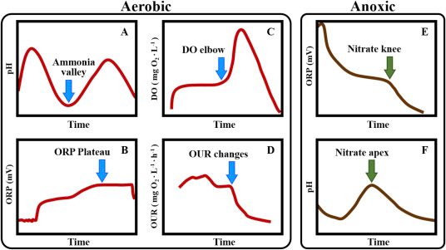
POSSIBLE CONTROL STRATEGY
Using the ORP and pH profiles there are several points to take note
On the pH profile
Ammonia valley: Local min
Nitrate apex ↔ Nitrate knee
On the ORP profile
Nitrate knee: Point where NO₃⁻ is
significantly removed
DO elbow ↔ Ammonia valley
4

Slide 10
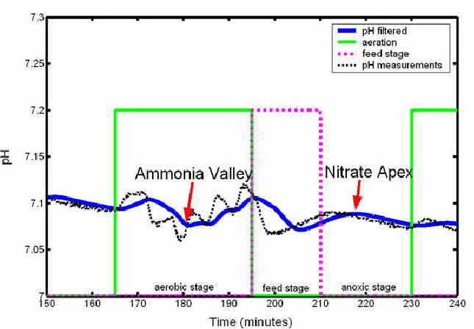
USING THE pH PROFILE
Ammonia valley tells one:
End of nitrification
End of aerobic period
Start anaerobic period
Nitrate apex tells one:
Corresponds to the nitrate knee
End of denitrification
End anaerobic period
Start aerobic

Slide 11
REFERENCES

